Slide 1
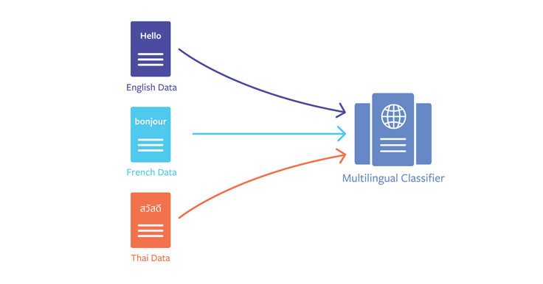



Insurance Bordereaux Column Mapping: Model Comparison
Analysis of Different Approaches for Column Mapping
Performance Evaluation and Results

Slide 2
Introduction
Challenge
Mapping insurance bordereaux columns to a canonical schema
Need
Handle variations in column names, languages, formats
Solution
Tested multiple approaches to identify optimal method
Goal
Achieve accurate, automated column mapping

Slide 3
The Challenge
Different languages
Synonyms and terminology variations
Insurance Bordereaux Data
Column names vary significantly across sources
Typos and abbreviations
Formatting differences
Need for reliable automated mapping to standard schema

Slide 4

Approach 1 - Multilingual Embedding (mpnet-base-v2)
sentence-transformers/paraphrase-multilingual-mpnet-base-v2
Semantic embeddings + cosine similarity mapping
Strengths
Limitations
Good for multilingual content
Misses typos and abbreviations
Handles synonyms effectively
Struggles with formatting differences
Many columns remain UNKNOWN
Result: 33.3% accuracy (11/33 correct)

Slide 5

Approach 2 - Multilingual Embedding (MiniLM-L12-v2)
sentence-transformers/paraphrase-multilingual-MiniLM-L12-v2
Same as Approach 1, but lighter/faster model
Strengths
Limitations
Faster processing
Similar limitations as Approach 1
Still handles multilingual content
Still leaves many columns as UNKNOWN
Result: 36.4% accuracy (12/33 correct)

Slide 6
Approach 3 - Merged Embedding + Fuzzy Logic
MiniLM-L12-v2 + rapidfuzz (fuzzywuzzy logic)
Embedding similarity first, then fuzzy string matching fallback
Strengths
Limitations
Handles both semantic and textual similarity
Requires both logic implementations
Effectively reduces UNKNOWN mappings
Depends on schema aliases
Addresses limitations of pure embedding approaches
Result: 100% accuracy (33/33 correct)

Slide 7

Approach 4 - Unsupervised Clustering
MiniLM-L12-v2 (no schema)
Groups columns by semantic similarity without canonical mapping
Strengths
Limitations
No schema required
Does not standardize to canonical schema
Reveals groups of similar columns across languages
Only clusters similar columns
Result: Useful for exploratory analysis but not for direct mapping

Slide 8
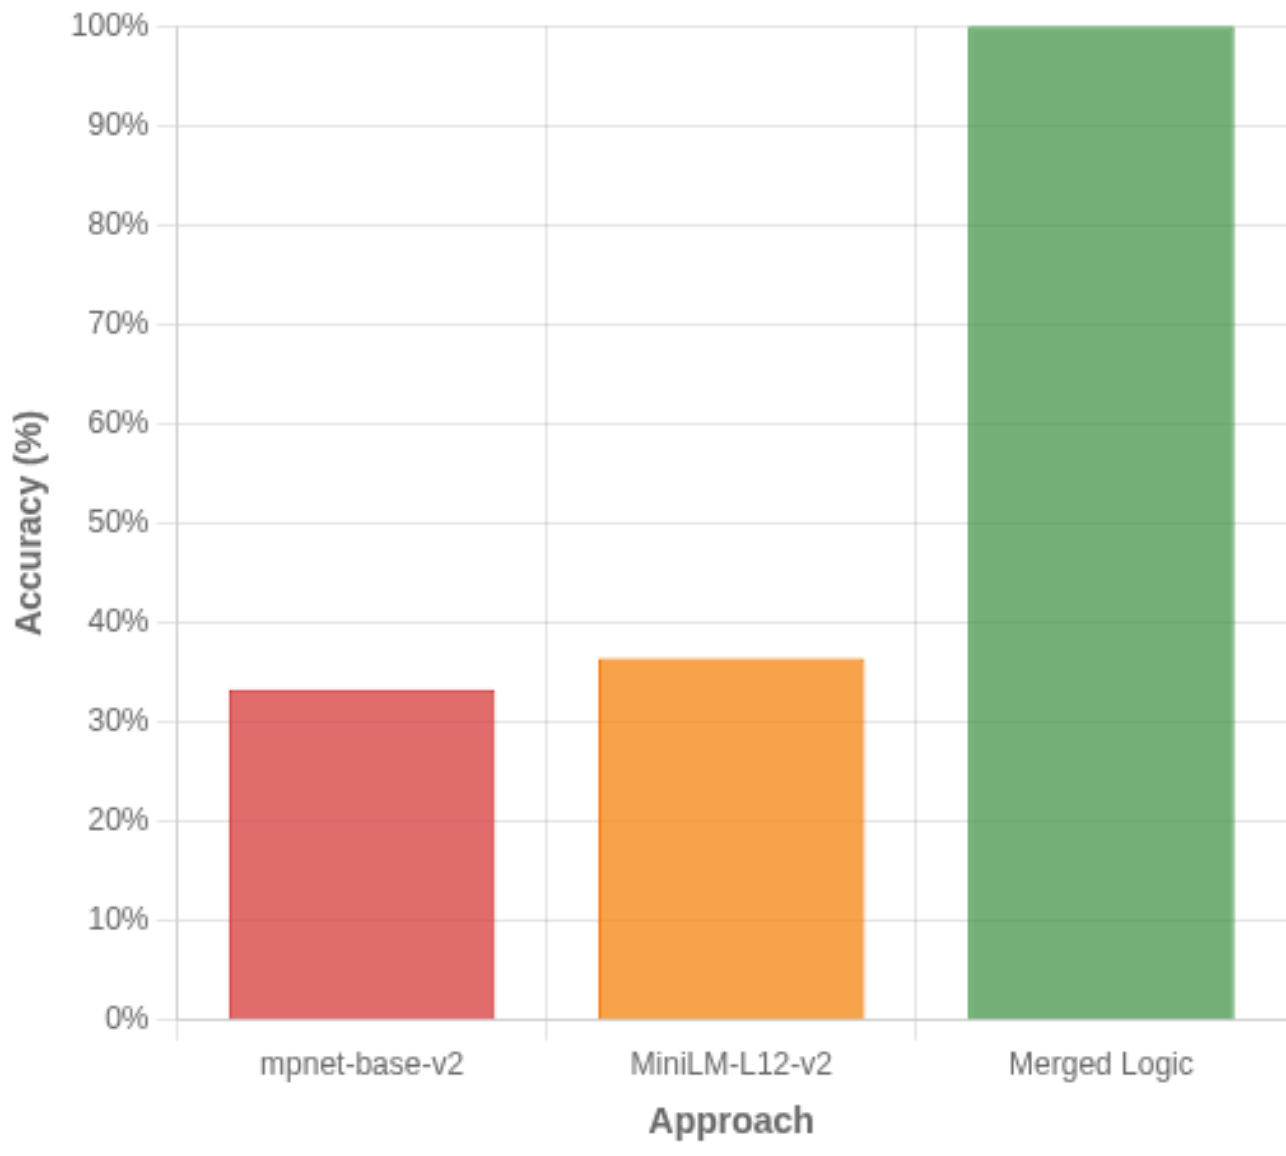
Results Summary
Performance Comparison
Accuracy Comparison

Slide 9
What We Discovered
Embedding Models Alone
Hybrid Approach Capabilities
Only 33-36% accuracy
Effectively handles multiple data challenges:
Left many columns as UNKNOWN
Multilingual content
Synonyms & terminology
Limited ability to handle textual variations
Typos & abbreviations
Formatting differences
Combined Approach
Key Insight
Embedding + fuzzy logic dramatically improved performance
Semantic understanding + textual similarity = Complete solution
Achieved perfect 100% accuracy
Fuzzy logic bridges gap when embeddings fail
Successfully mapped all columns
Schema aliases crucial for mapping success

Slide 10

Production Solution
Recommended Approach
Merged Embedding + Fuzzy Logic
Why
Implementation Considerations
100% accuracy
Requires both embedding & fuzzy logic
Handles full range of data variations
Depends on well-defined schema aliases
Robust solution for production
Acceptable processing time
Zero manual intervention
Scales for production workloads

Slide 11
Implementation Roadmap
1
Finalize Schema
2
Implement Merged Logic
Define canonical columns and create comprehensive alias mappings for all variations
Deploy embedding + fuzzy matching solution in production environment with proper error handling
3
Develop Monitoring
4
Create Feedback Loop
Create dashboard to track mapping accuracy, processing time, and system performance metrics
Implement continuous improvement process to collect corrections and enhance mapping rules
5
Extend Capabilities
Expand solution to handle additional languages and data formats as business needs evolve
Timeline: 3-4 months for full implementation with phased rollout

